Slide 1


Capstone Project Computer Vision
Mercedes AMG Petronas Formula One Team
Team Principle & CEO
Managing Director
Technical Director
Driver 1
Driver 2
3 December 2020
Presenter: Ricky K Nguyen

Slide 2
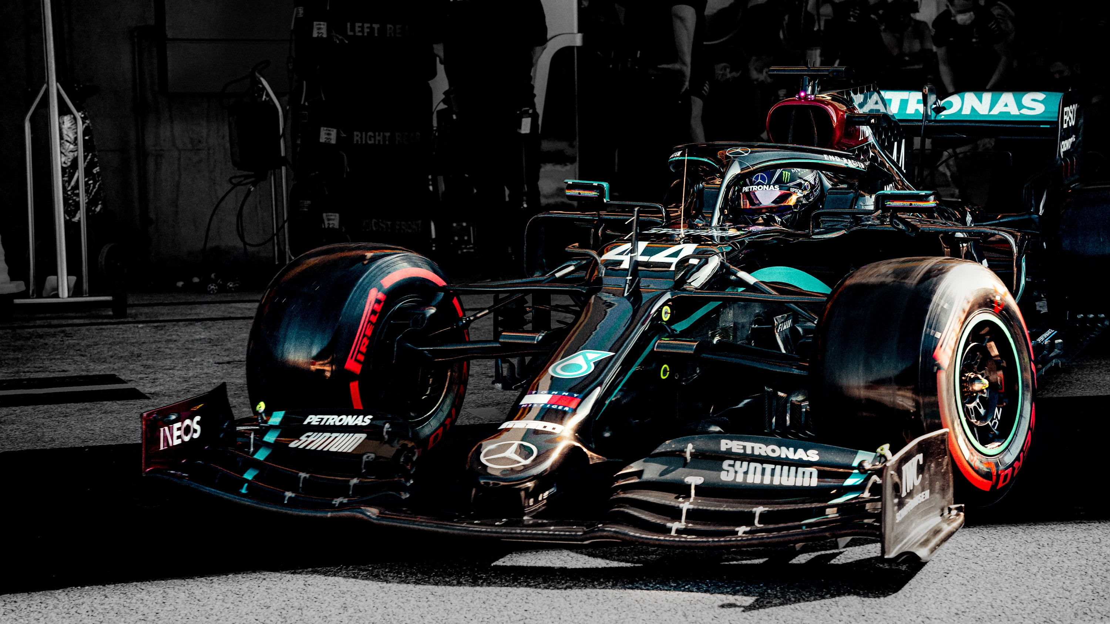
Business Context
Business Question
Project Pipeline
Data Description
Data Preprocessing
Modelling
Object Detection
Recommendation
Future Application

Slide 3
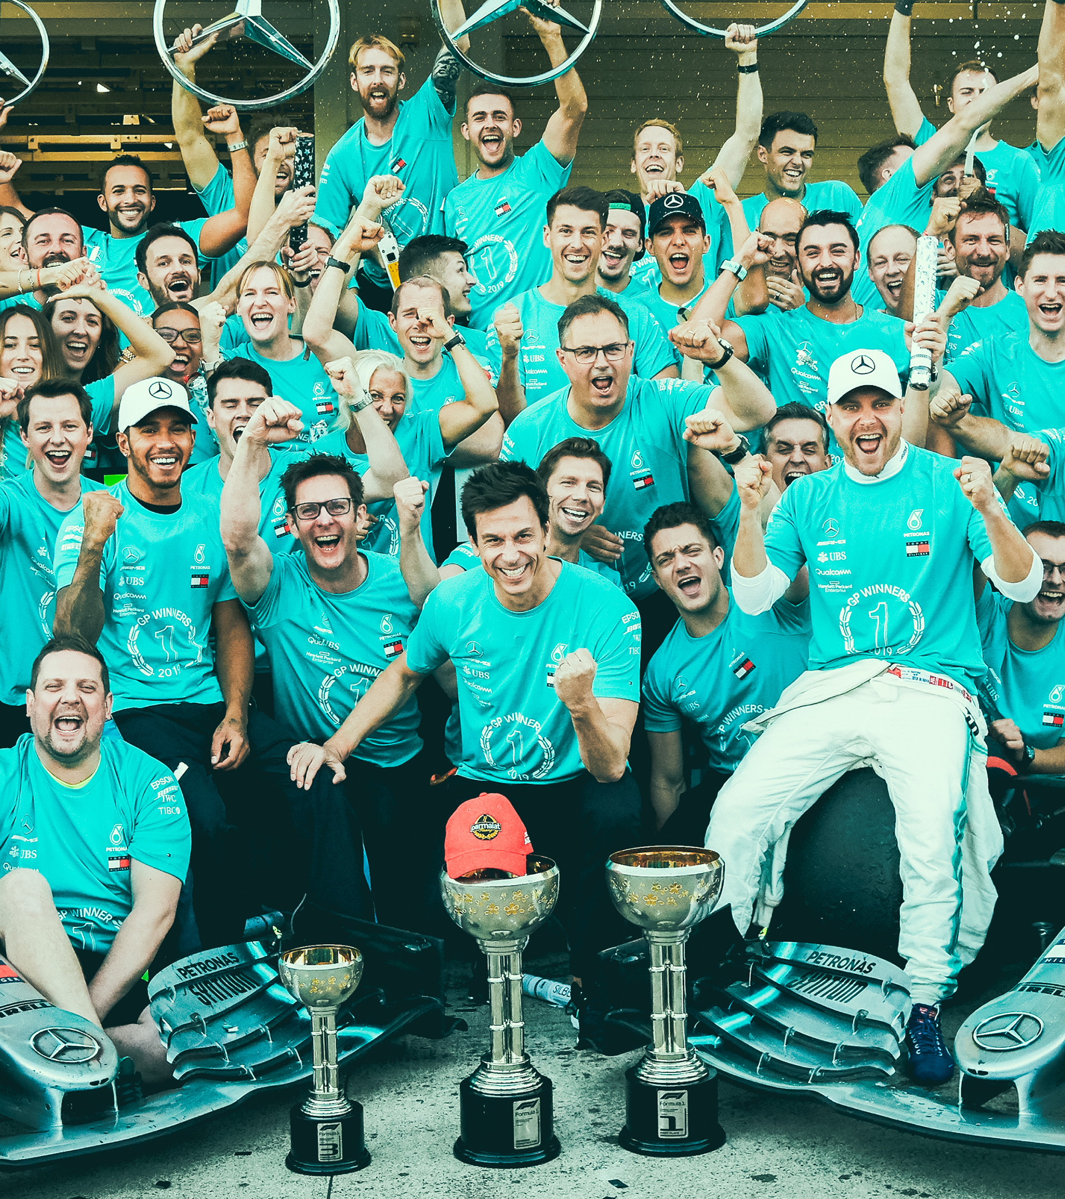

Mercedes Formula One
Increase brand’s popularity and sales
Estimated to spend in excess of $400 million a season
Employed between 800-1000 staff
Engineers monitored car’s performance and durability. Driver focus on Attack or Defense their position.
Engineers also notify driver on key strategy like rival racing position

Slide 4
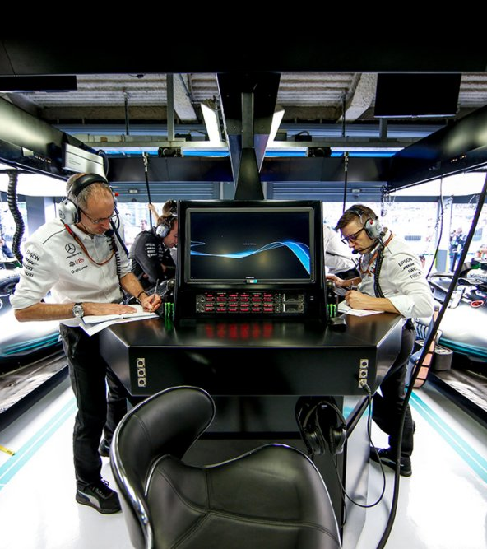
Business Question
How can we reduce miscommunication between engineer and driver? Especially, when it come to rival’s position
Data Question
How can we use Artificial Intelligence to identify F1 driver on the track?

Slide 5
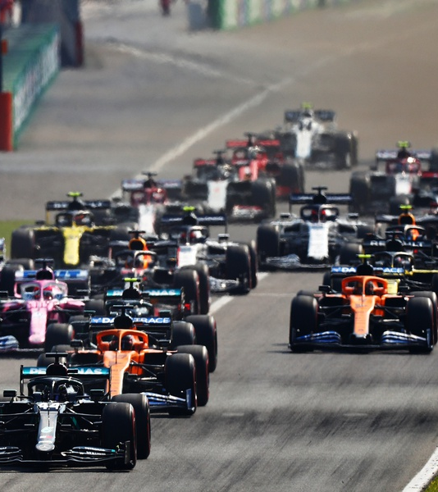
Data Description
Images were extracted from recorded videos and web images from 2017-2019 season.
Images have variety of backgrounds, random objects and lighting conditions.
Training: 340 images
Validation: 60 images
Smallest image: 275 x 183 x 3
Largest image: 3762 x 2508 x 3

Slide 6
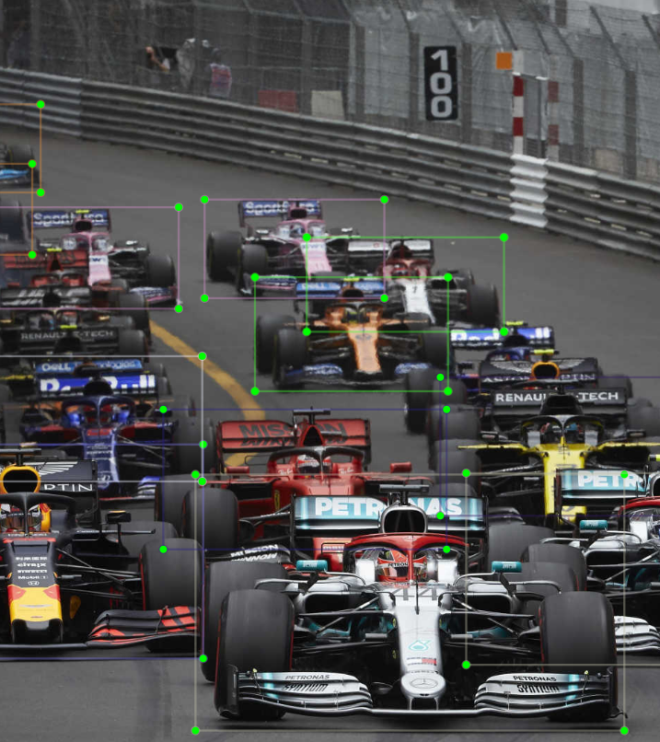
Data preprocessing
Resize images to 600x900 pixels
Label images to their classes

Slide 7

Modelling
Real-Time Detection Speed
Faster RCNN ResNet101 architecture
24 hours of training
Total loss score between 0.2 ~ 0.4
Improve result by continue to train the model
0.2s
2.3s
49s
Faster RCNN
Fast RCNN
RCNN

Slide 8
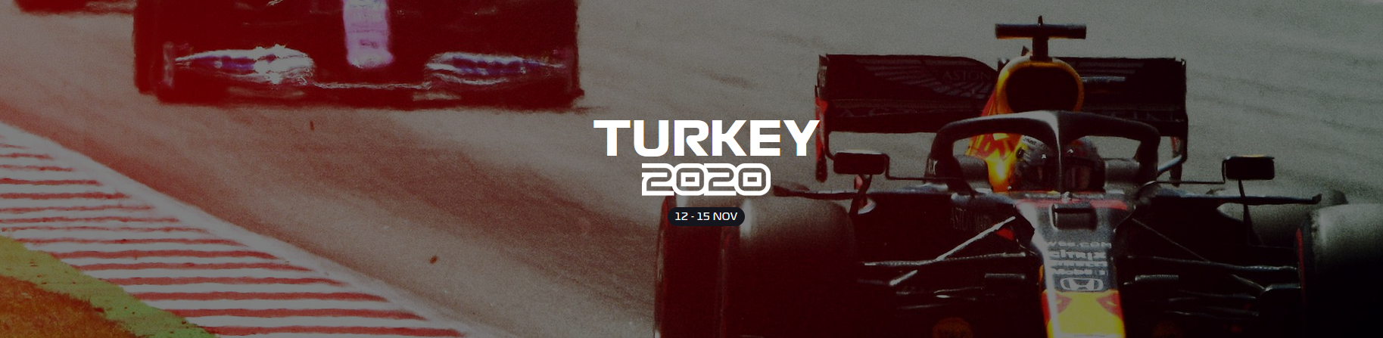
Object detection in action
Extract inference graph (Trained Model)
Turkey 2020 Grand Prix (Wet Race - Unseen Data)

Slide 9
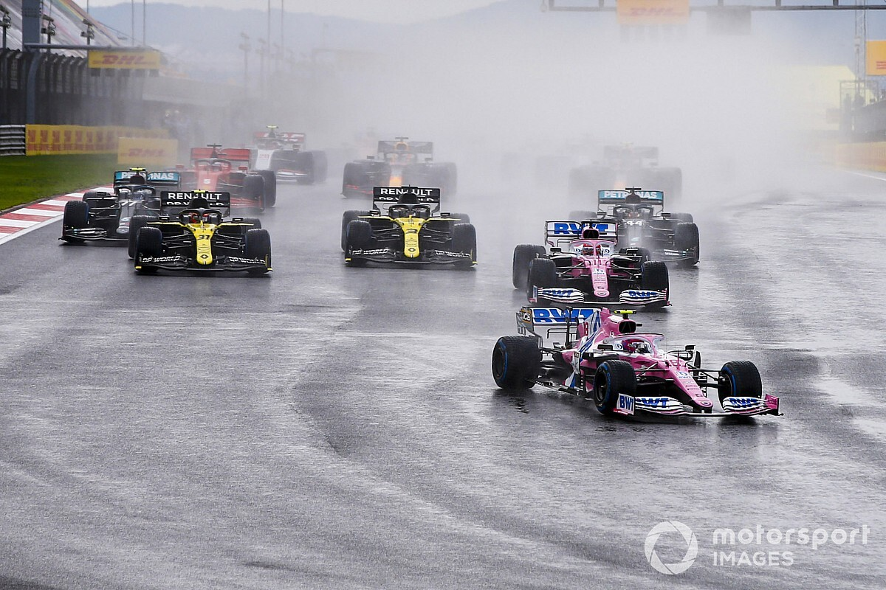
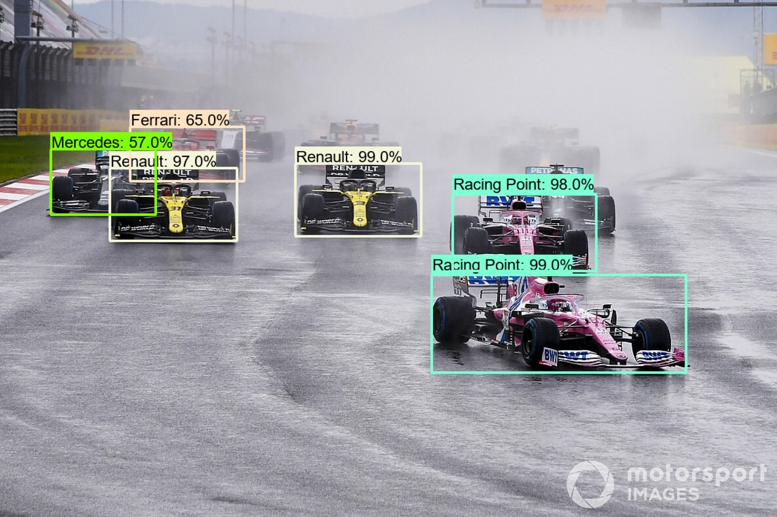
2020 Turkey Grand Prix – Frame 1
Original Image
Detected Image

Slide 10
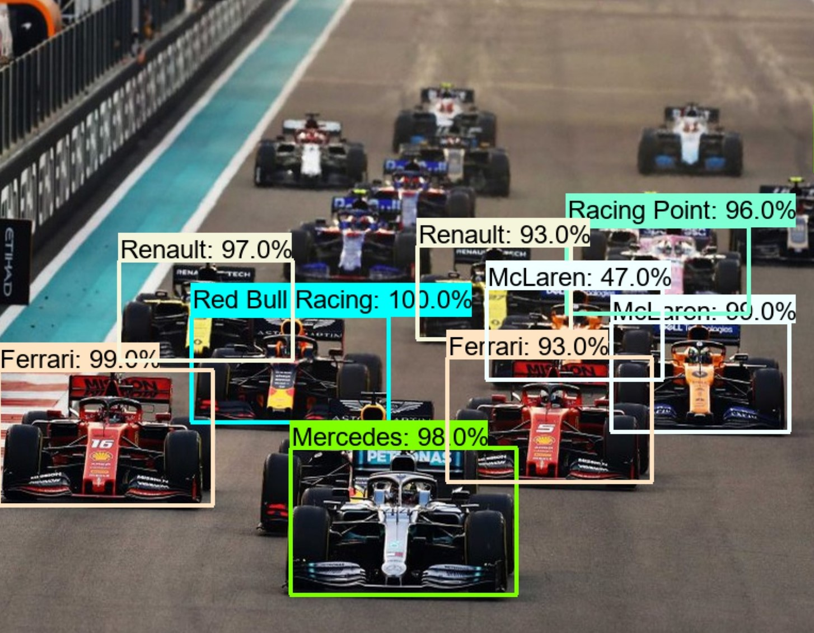
Recommendation
Fail to identify rival’s position leads to poor decision-making of F1 Driver & Engineer.
Eliminate engineer’s role of rival notification.

Slide 11
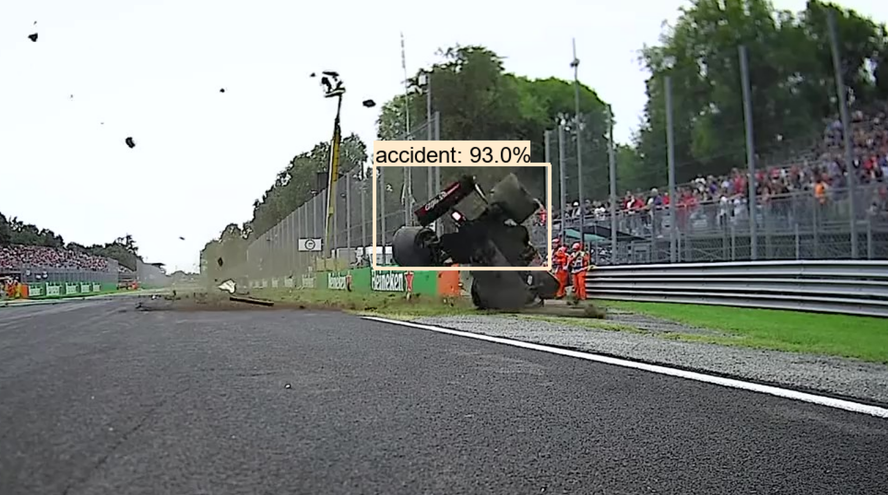
Future Application
Detect accident & crashes
Detect debris on racetrack

